Slide 1
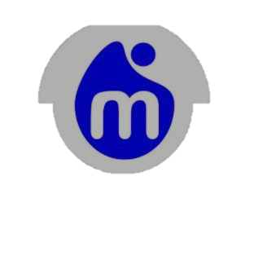
MOOBIQ COMMUNITY
Notes:
BY SHEHU

Slide 2
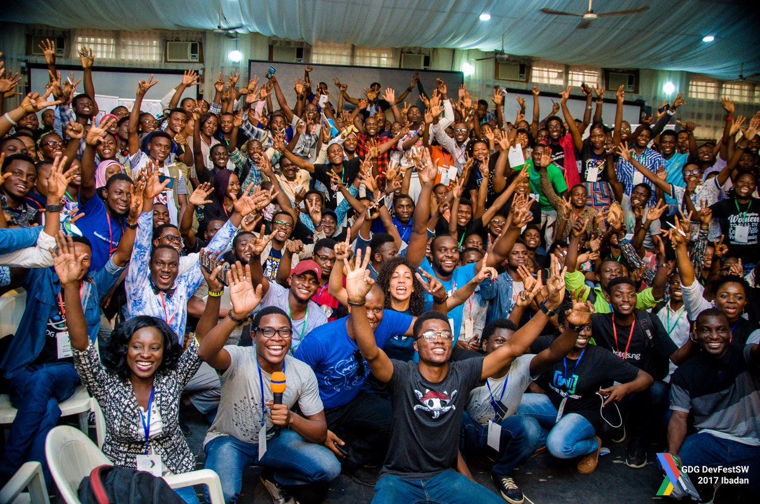
WHAT IS MOOBIQ COMMUNITY
Moobiq community is an innovative platform designed to promote collaboration, mutual support and economic empowerment among its members.
It connects businesses, individuals, professionals, and families for remote work and digital opportunities.

Slide 3

OBJECTIVES
Sharing resources through discounts and subsides on goods and services using the Mobic discount credit system.
Building a network of professionals, service providers, entrepreneurs, and experts who offer quality products and services.
Supporting digital work by connecting people to remote work force opportunities.
Access to data and digital learning.
INNOVATION: Moobiq Community is a real time virtual community where we are creating digital economy to add more values to humanity in the real world.

Slide 4

BENEFITS FOR MEMBERS
Free access to data and digital learning resources.
Business and investment opportunities, financial services, and lending.
Community support through the ecosystem.
Food supplies for families and social welfare support.
Digital assets mining/ acquisition and social networking.
Access to remote work and digital job listings shared within the community.

Slide 5

WHO MOOBIQ IS FOR
The community includes;
Professionals and experts offering services.
Entrepreneurs and service providers looking for customers.
Families and individuals seeking affordable goods and income opportunities.
Remote workers and digital learners.

Slide 6

HOW IT WORKS
Join the ecosystem via moobiq.com.
Earn the use Mobic credit to get discounts/ subsides on essentials.
Access opportunities in digital learning, jobs, and business partnerships.
Network and collaborate with other members to grow skills and income.

Slide 7

WHY IT MATTERS FOR YOUTH DEVELOPMENT
Moobiq aligns with youth empowerment through digital skills because it;
Provides low cost access to learning ang tools.
Creates income opportunities without needing large capital.
Building a support network for young entrepreneurs and remote workers.
Encourages collaboration over competition.

Slide 8
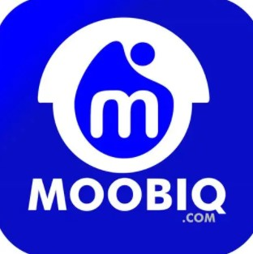
CONCLUSION
Moobiq isn’t just a marketplace- it’s a community built on the idea that when people collaborate and share resourses, everyone benefits.
For Nigerian youths facing unemployment and high costs, it offers a practical model for economic self-reliance through digital connections.

